Slide 1

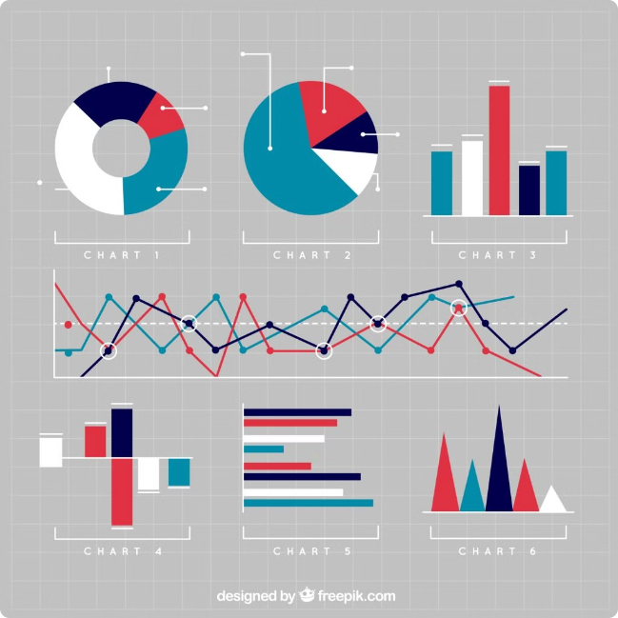
Disease Pattern Analysis System
INTRODUCTION:
A Disease Pattern Analysis System (DPAS) is designed to monitor and analyze disease trends within populations. It collects data from various sources such as health records, surveys, and environmental factors to detect and predict disease patterns. By using advanced analytical techniques and visualization tools, DPAS helps public health officials identify outbreaks early, forecast future trends, and make informed decisions to improve health outcomes. Key aspects include integrating diverse data sources, analyzing spatial and temporal patterns, and generating actionable insights to enhance public health responses.

Slide 2


Data Collection and Ingestion
1
Data Sources
The system gathers data from various sources, including electronic health records, disease registries, and public health surveillance systems.
2
Data Validation
Before ingestion, data undergoes rigorous validation to ensure accuracy, completeness, and consistency.
3
Data Storage
Validated data is stored in a secure and scalable cloud database, allowing for efficient retrieval and analysis.

Slide 3


Data Processing and Transformation
1
Data Cleaning
2
Data Aggregation
The system applies data cleaning techniques to remove inconsistencies, missing values, and outliers, enhancing data quality.
Data is aggregated based on factors like location, time, and disease type, enabling meaningful comparisons and analysis.
3
Feature Engineering
4
Data Transformation
New features are derived from the existing data to enhance the prediction accuracy of models.
Data is transformed into a format suitable for machine learning algorithms, ensuring compatibility with the analysis process.

Slide 4
Disease Pattern Analysis
Statistical Analysis
Machine Learning
Predictive Modeling
Descriptive statistics are calculated to reveal key trends and patterns in disease occurrence.
Advanced machine learning algorithms are applied to identify risk factors, predict disease outbreaks, and forecast future trends.
Predictive models are developed to anticipate disease patterns and provide early warnings for potential outbreaks.

Slide 5

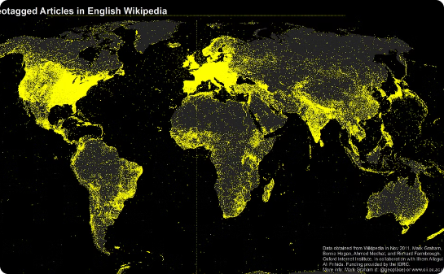
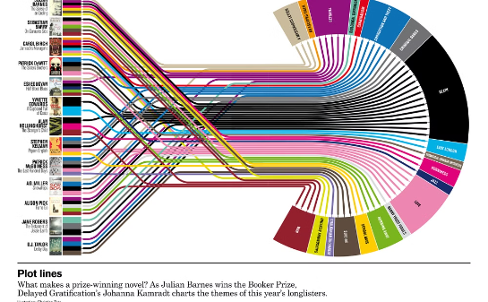
Visualization and Reporting
Interactive Dashboards
Geographic Maps
Trend Graphs
The system generates interactive dashboards that allow users to explore data visually, filter by various criteria, and gain insights.
Disease patterns are visualized on interactive maps, highlighting regional variations and potential hotspots.
Time-series graphs depict trends in disease occurrence, providing valuable insights into disease dynamics.

Slide 6
Deployment on Azure Cloud
Azure Storage
Azure Compute
The system leverages Azure storage services to store vast amounts of data securely and efficiently.
Azure compute resources provide the necessary processing power for data analysis and model training.
Azure Analytics
Azure analytics services enable advanced data processing, analysis, and visualization.

Slide 7





Scalability and Reliability
Scalable Infrastructure
The Azure cloud platform offers on-demand scalability, ensuring the system can handle growing data volumes and increasing analytical demands.
High Availability
The system is designed with redundancy and failover mechanisms, ensuring high availability and minimizing downtime.
Data Security
Data security is a top priority, with robust measures in place to protect sensitive information from unauthorized access.

Slide 8

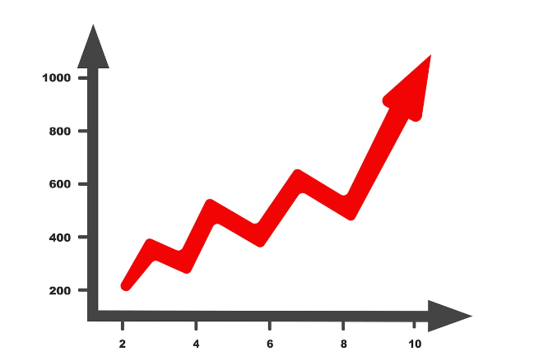
Conclusion
This cloud-based disease pattern analysis system offers a comprehensive solution for collecting, processing, analyzing, and visualizing disease data. By leveraging the power of Azure cloud, it provides insights into disease trends, patterns, and potential outbreaks, empowering public health professionals to make data-driven decisions and improve disease management strategies.

Slide 9




Thank you

